Slide 1
My Book Report Collage
Elise L.

Slide 2
The Leopard in the Golden Cage
Book One of The Scar Gatherer Series
(There are seven books in total)

Slide 3
With help from
Minecraft

Slide 4
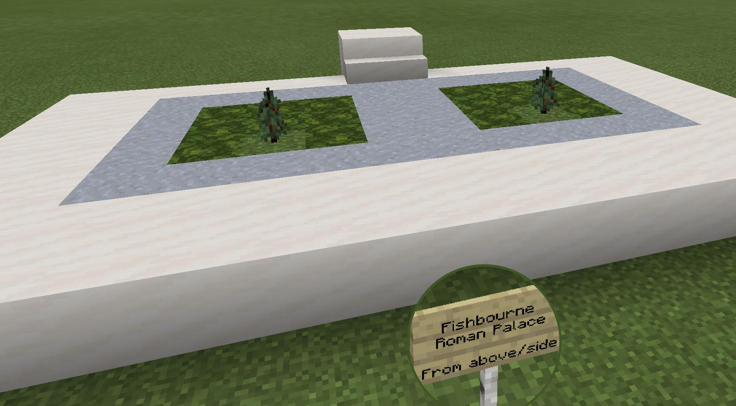

Slide 5
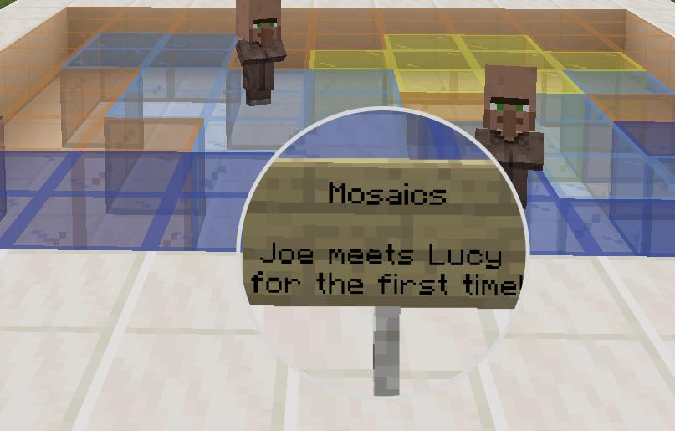

Slide 6
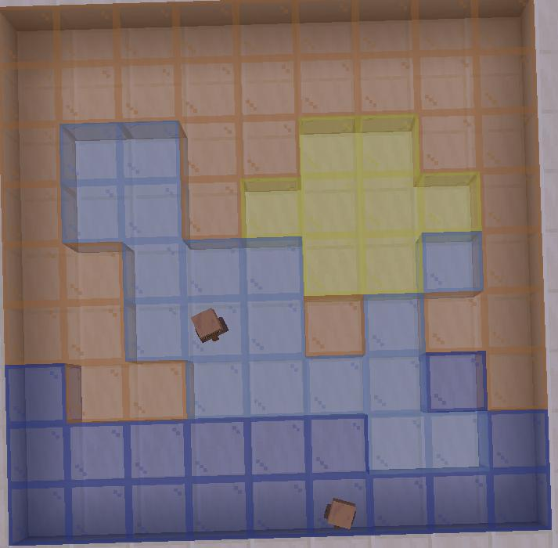
*Dolphin Mosaic

Slide 7
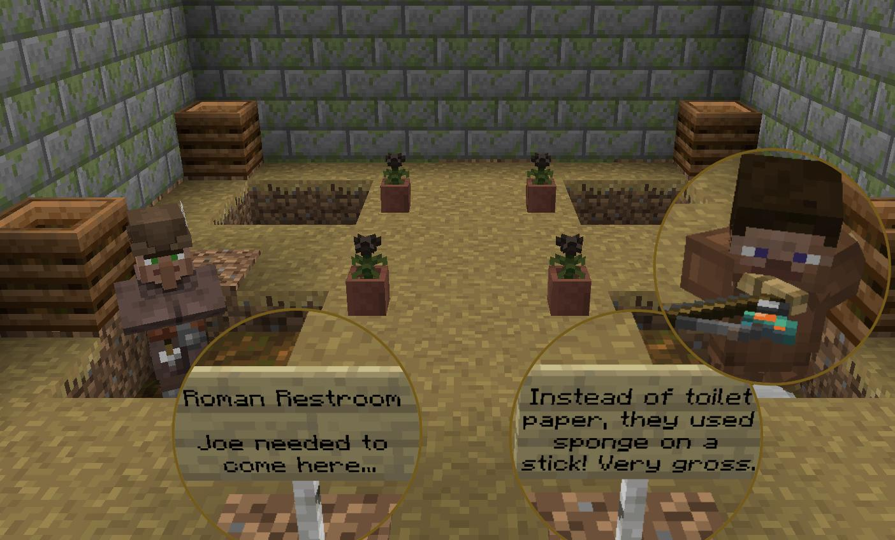

Slide 8
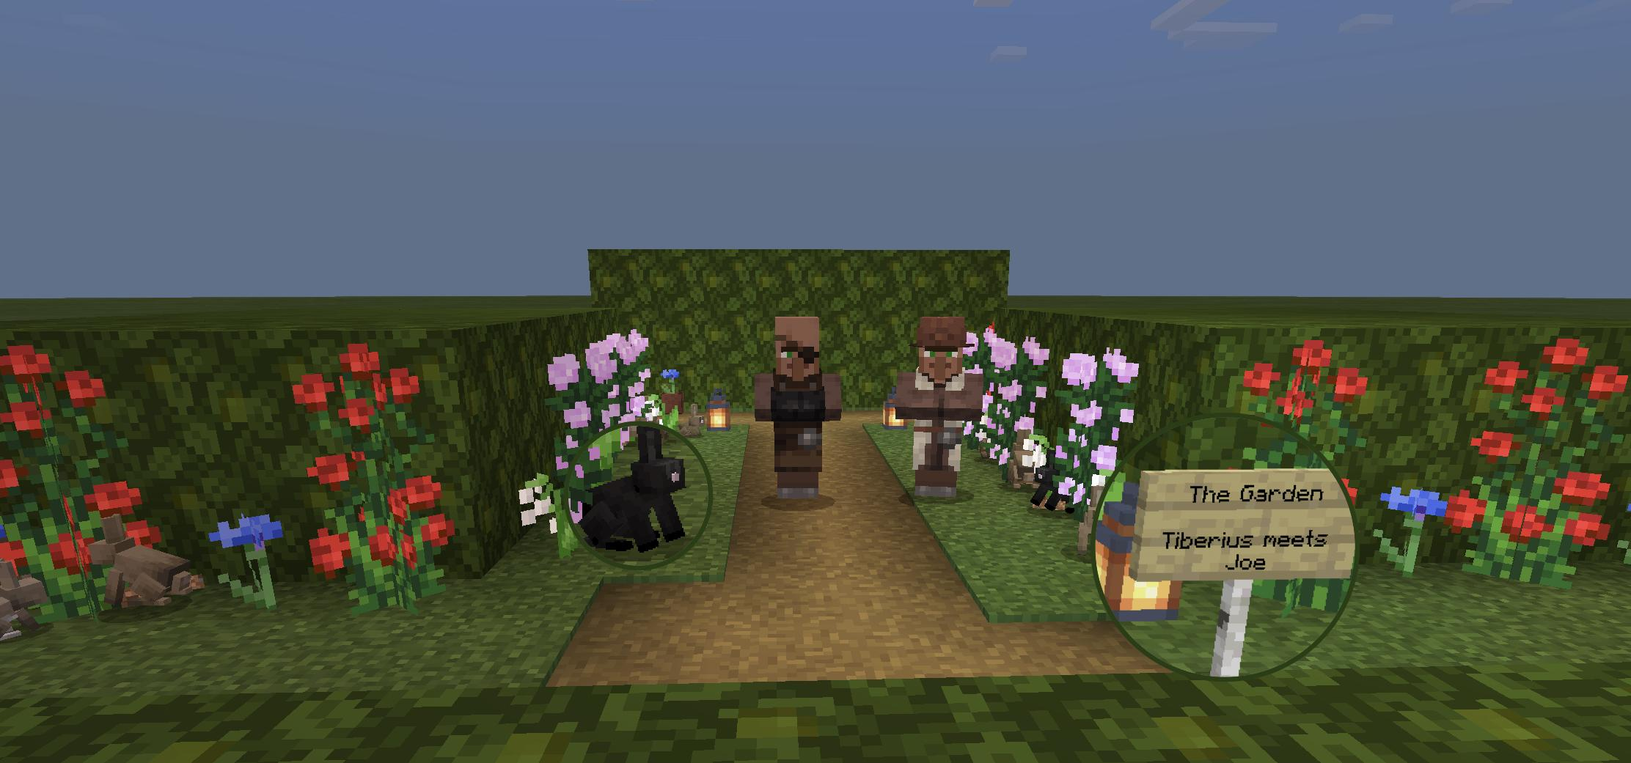

Slide 9
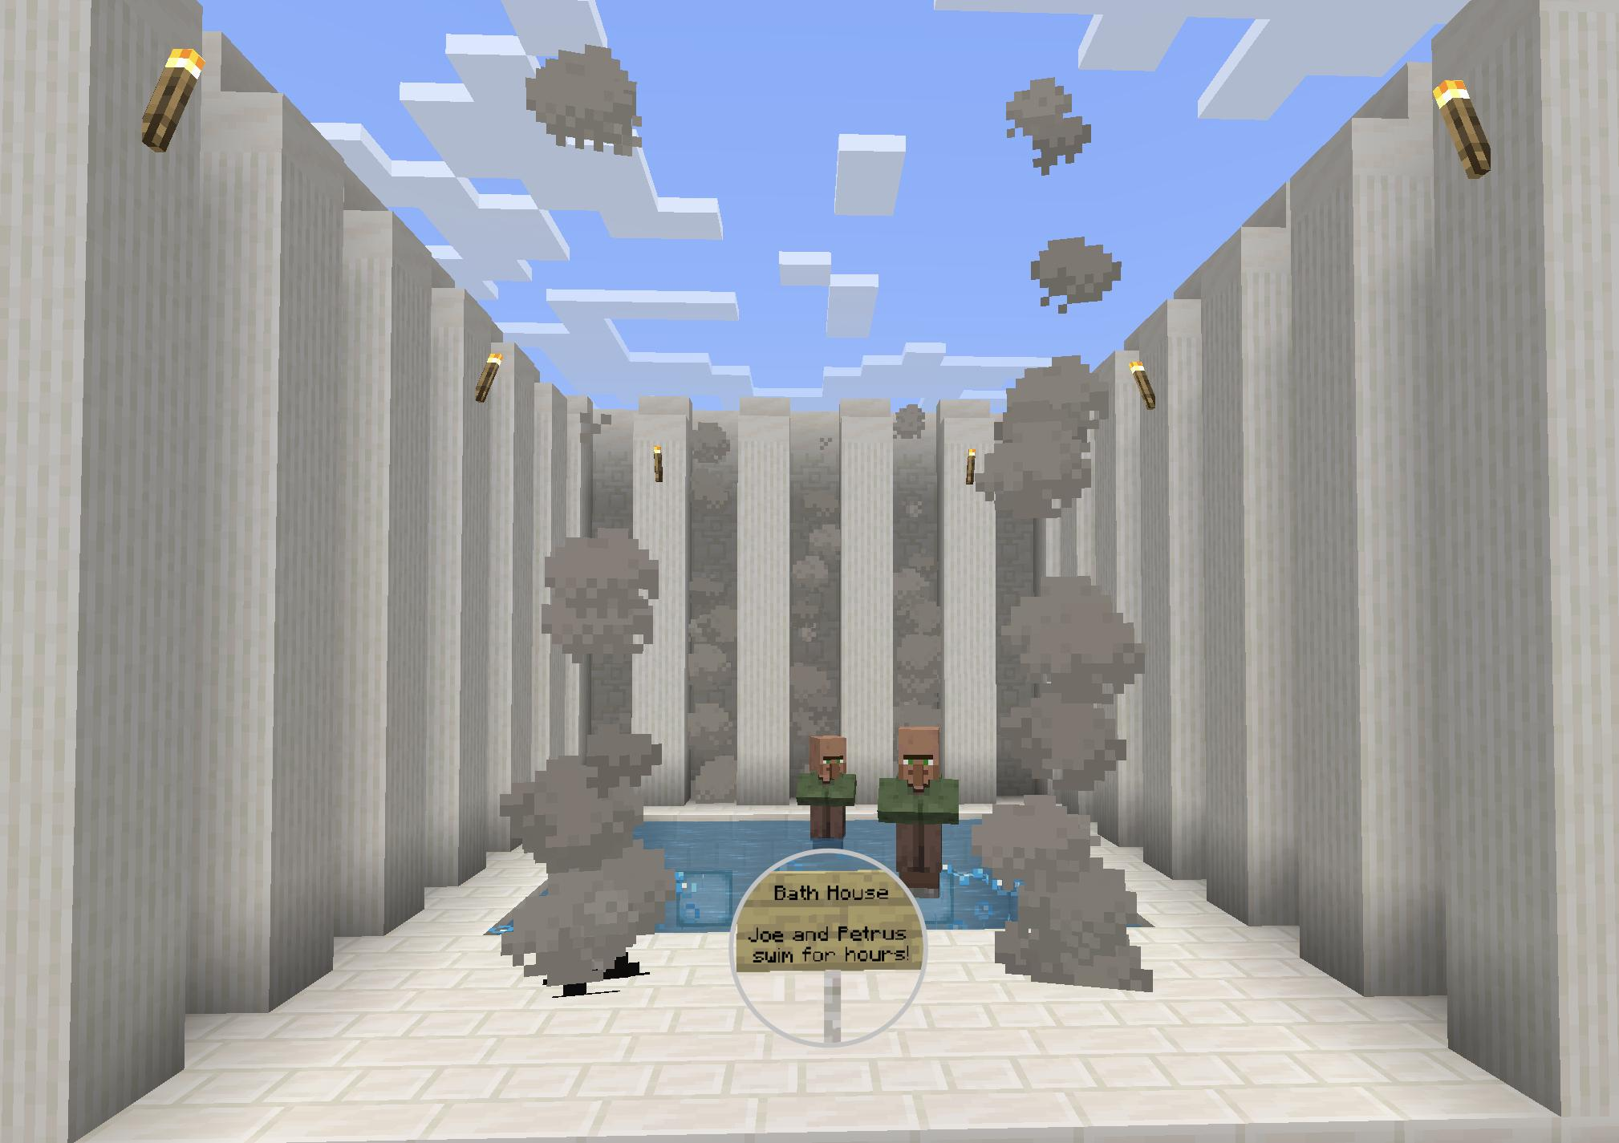

Slide 10
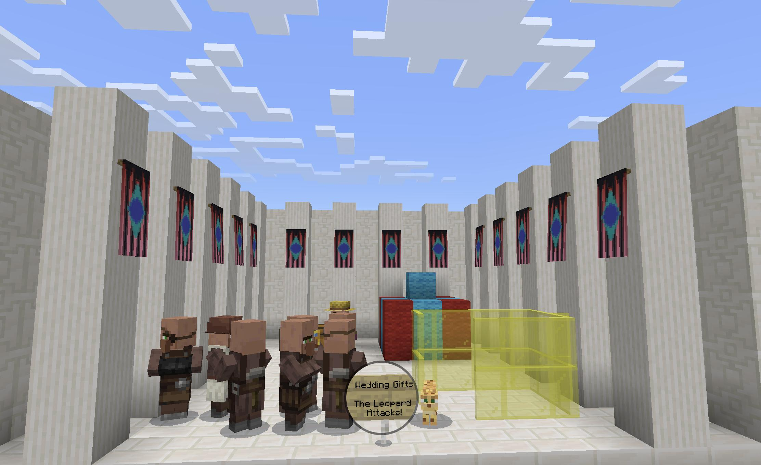

Slide 11
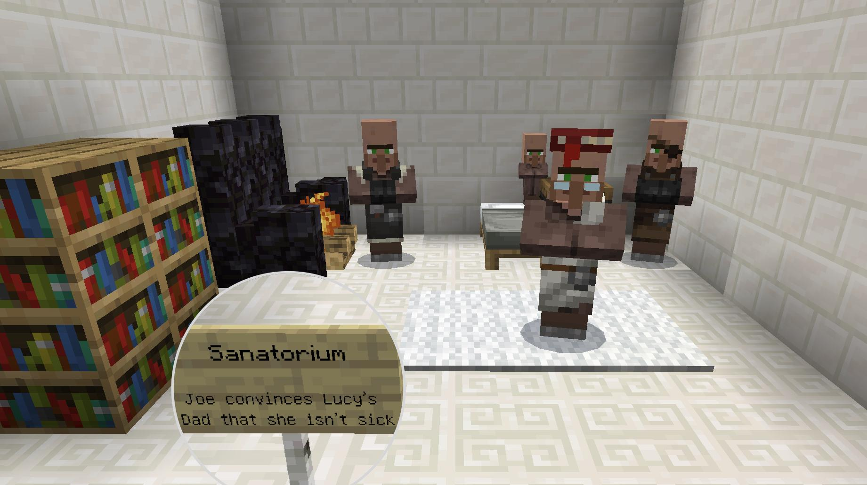
tries to convince

Slide 12
If you’re interested, I own a signed copy of this book, which I can lend to you.
(The author is a friend of my great uncle.)

Slide 13
Thank you for watching!

